Slide 1
VHE γ-ray astronomy nowadays: from present MAGIC results to CTA
E. Carmona

Slide 2
VHE γ-ray astronomy
- Motivation
- The technique

Slide 3
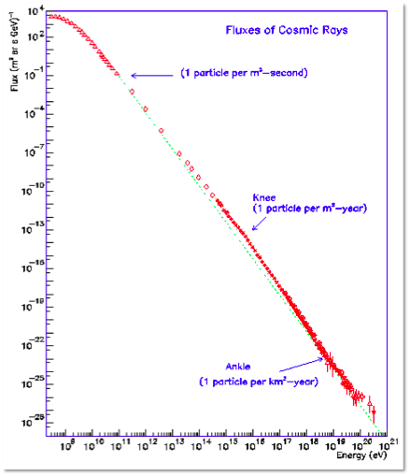
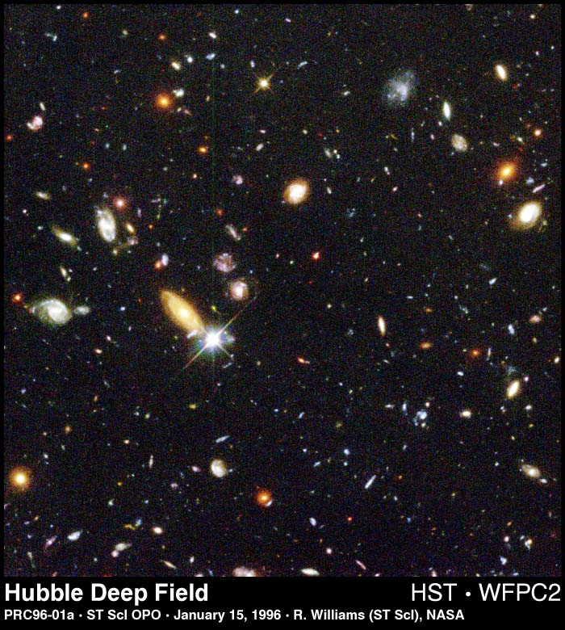
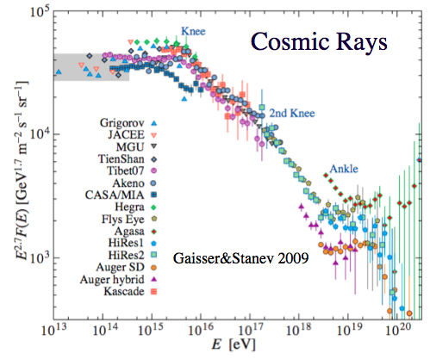
Studying the non-thermal Universe
Large fraction of radiation has a thermal origin
Fraction of the radiation we detect has a non thermal origin
Other mechanisms at work to produce the observed non-thermal radiation
Cosmic Ray spectrum extends 12 decades in energy, >32 in intensity
Origin of Cosmic Rays one of the most fundamental questions. Many aspects of Physics involved: Astrohphysics, shockwaves, plasma-physics, atomic, nuclear, particle-physics, exotic physics (SUSY), ...

Slide 4
What is a good messenger?

Slide 5
What is a good messenger?

Slide 6
What is a good messenger?

Slide 7
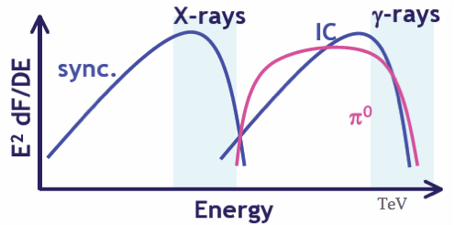
Origin of VHE γ-rays
After acceleration of charged particles, 2 processes can produce TeV emission:
  π⁰ decay: accelerated ions collide with ambient protons producing π⁰ −> γγ. Flux proportional to ambient density
  Inverse Compton (IC): accelerated electrons up-scatter ambient photons
  Target photons provided by CMB, dust or starlight
To understand the sources we should distinguish between these 2 scenarios (hadronic and electromagnetic)
It is difficult to differentiate by looking only to TeV emission. Need more wavelengths
Neutrino observation couldfinish the discussion

Slide 8

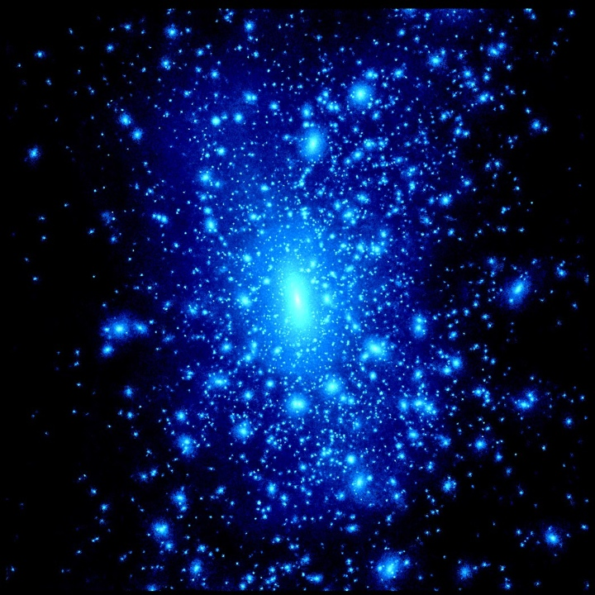
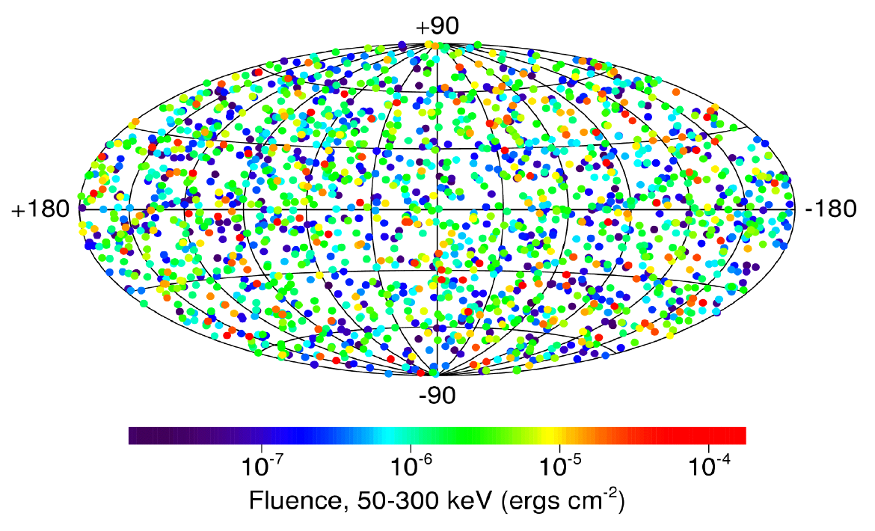
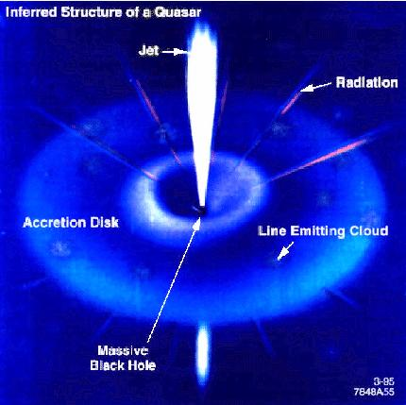
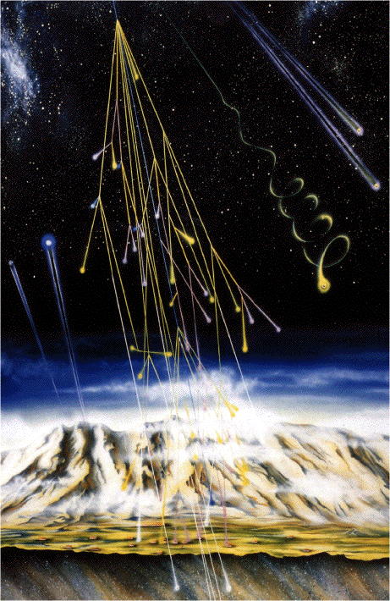
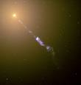
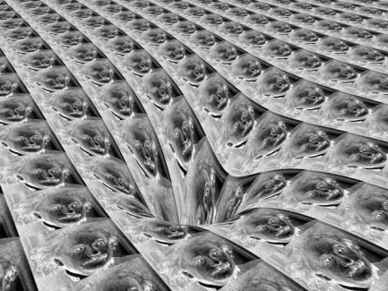
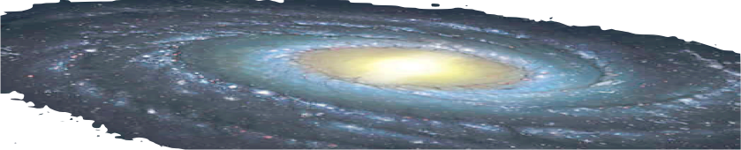
Extragalactic targets
GRBs
Dark matter
AGN
Origin of cosmic
rays
Radio galaxy
Fundamental
Physics

Slide 9

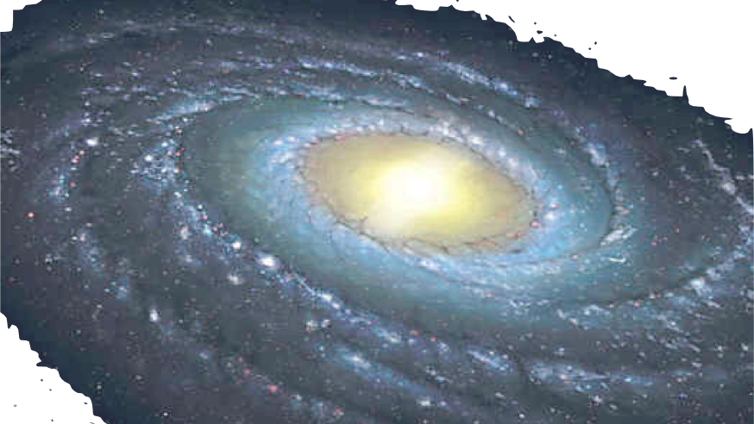
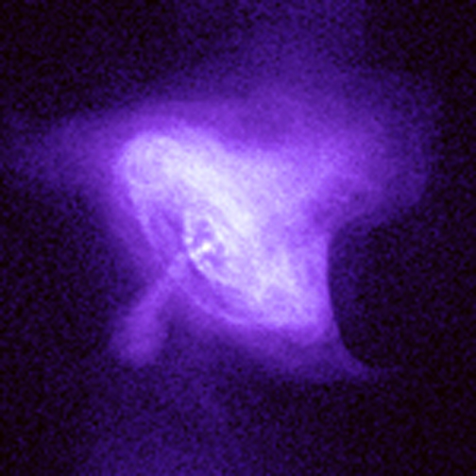
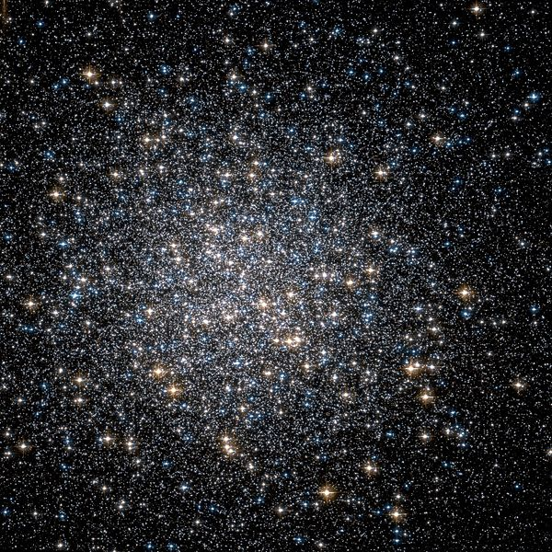
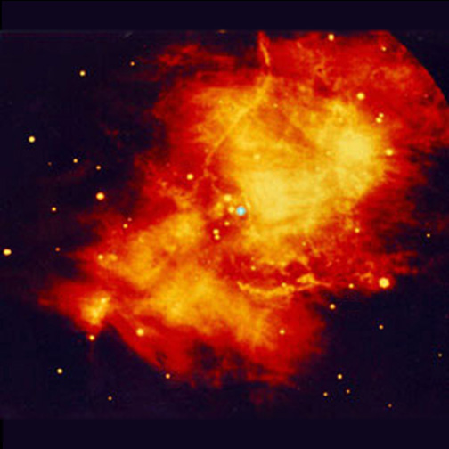
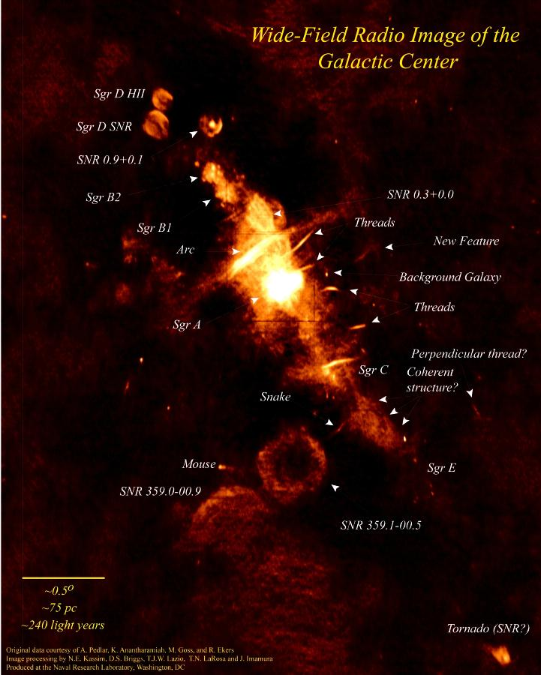
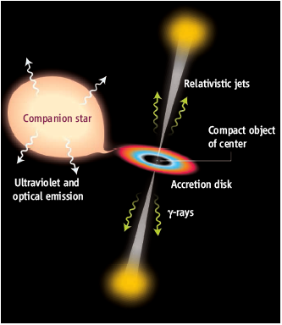
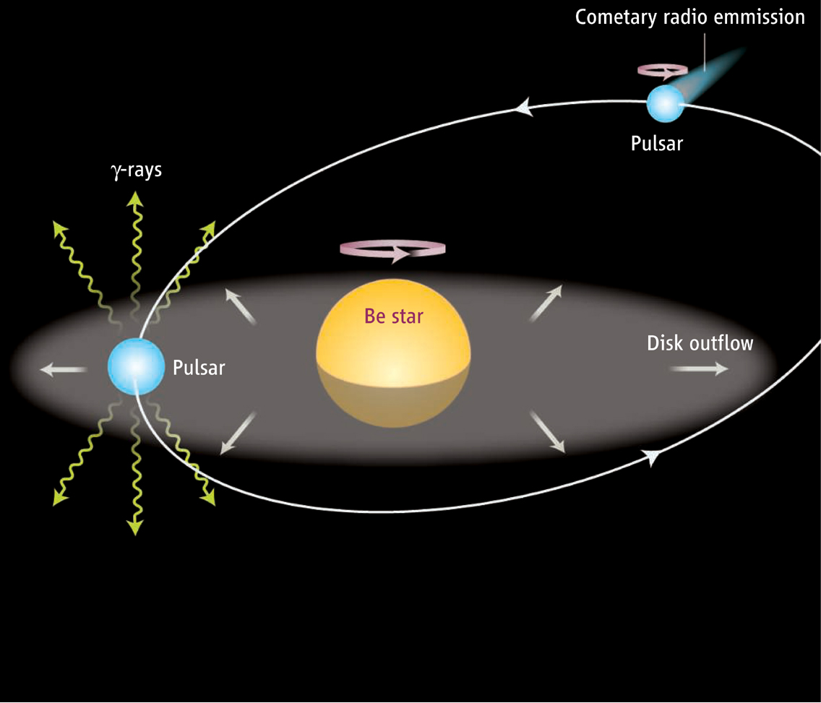
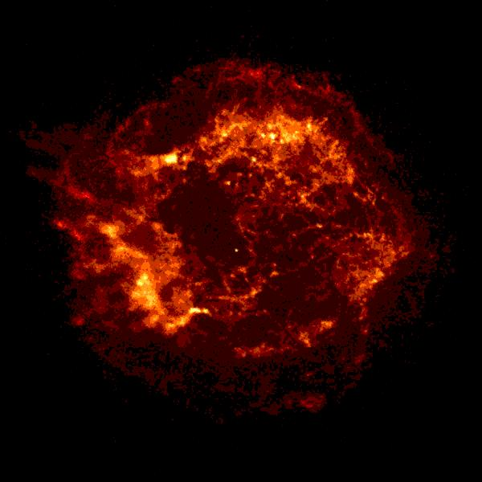
Galactic scientific targets
Origin of cosmic
rays
Globular
cluster
Pulsars
pulsar wind
nebula
galactic
center
μquasars
Binary
pulsar
SNRs

Slide 10
SNRs: origin of galactic cosmic rays
SNRs are believed to be the origin of galactic CRs
Expanding shock front from the SN explosion
Particles collide in the shock front gaining energy each time the cross the shock: Fermi acceleration
Result is a universal power law with index ~2.1
1SN / 30 years + 10⁵¹ erg/explosion. Only 10% of that energy into CRs would be sufficient
Gamma rays produced by IC of electrons or by decay of π⁰s after cosmic ray interaction with matter

Slide 11
Multiwavelength: Radio, X-rays and VHE γ-rays
For acceleration in SNRs:
  Synchrotron emission:
    Seen in radio and non-thermal x-rays and attributed to e⁻ accelerated in the SN shock
  Thermal X-rays:
    Useful to obtain density of gas near the shock
Role of B field:
High B increases losses of electrons and reduce max. energy by IC.
Low B reduces energy of hadronic γ-rays because CR escape
B
Energy flux
Emax
π⁰-decay
B
synchrotron radiation
B
IC
Radio
x-ray
Gamma ray

Slide 12
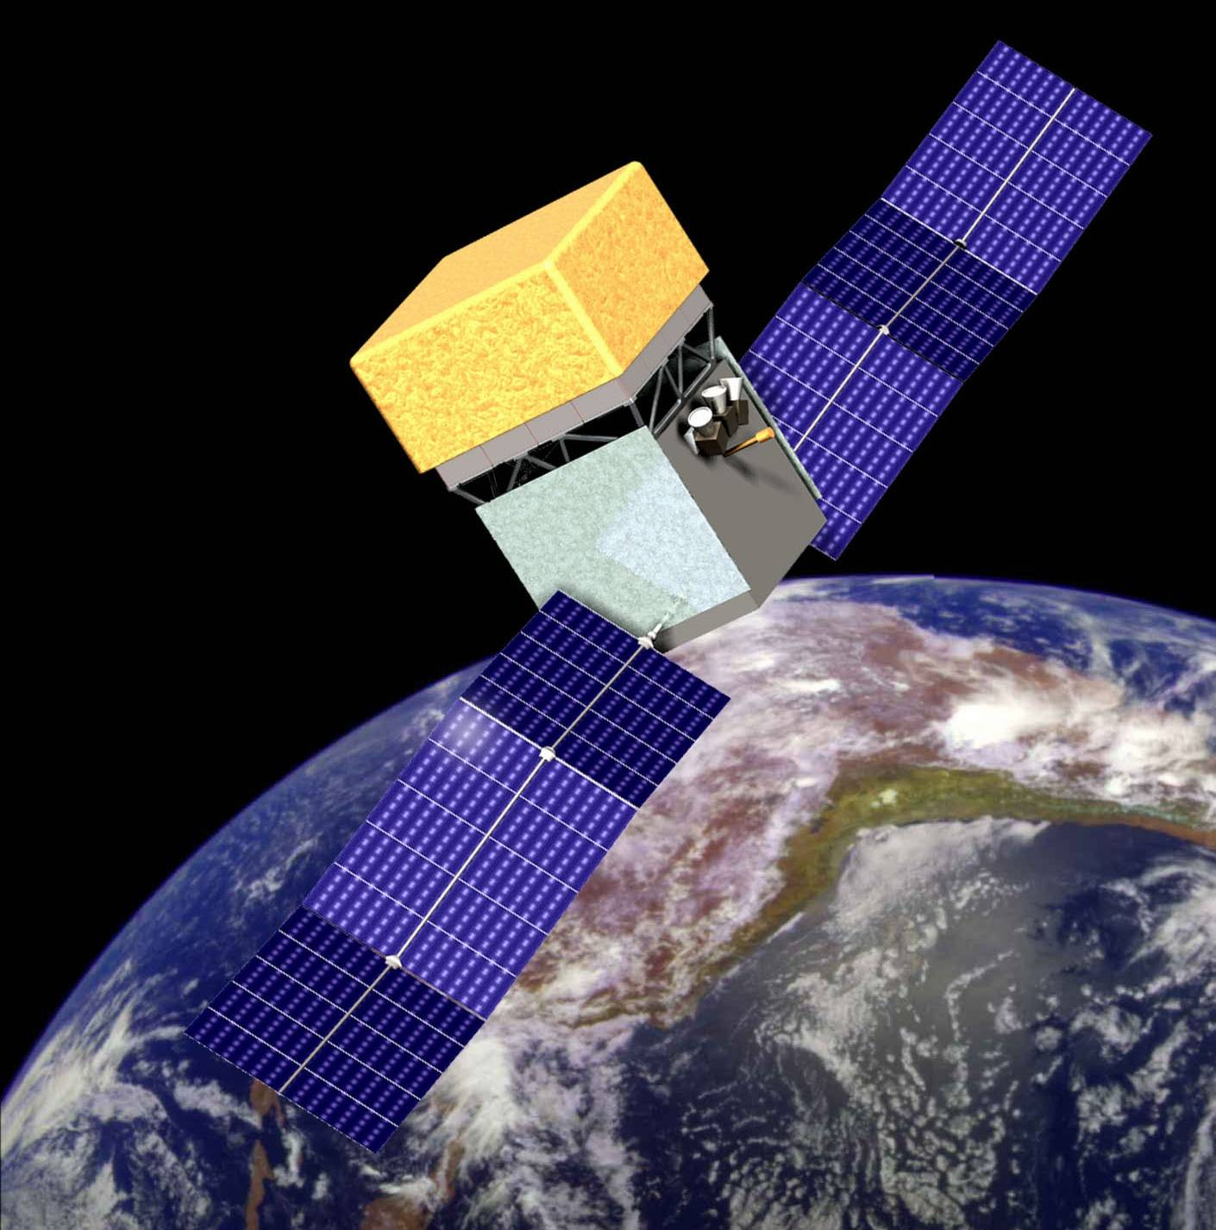
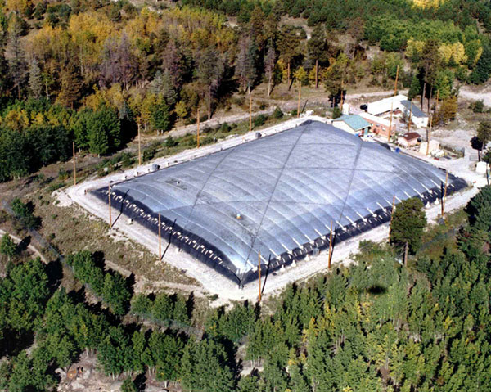
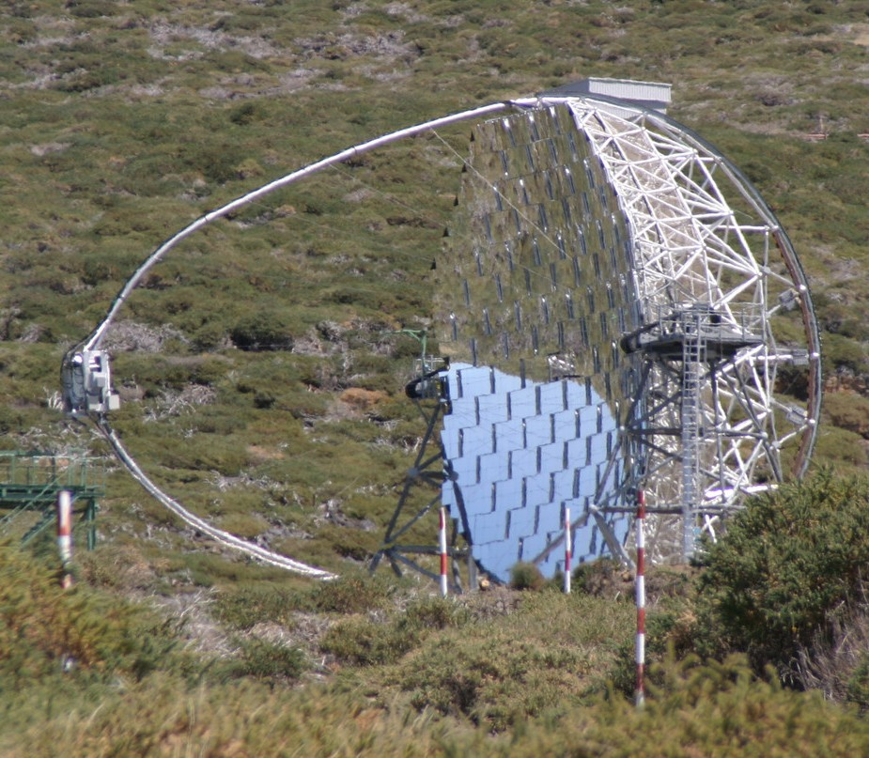
Gamma Ray astronomy: Satellite or Ground-based?
Satellites
Ground-based detectors
Air shower
arrays
~50 GeV − ~50 TeV
IACTs
~20 MeV − ~300 GeV
Primary detection
Small effective area
Large angular acceptance
Large duty-cycle
Low background
High cost
1 TeV and above
Secondary detection (EAS)
Large effective area
Large/small angular acceptance
Large/small duty-cycle
High background
Low cost

Slide 13
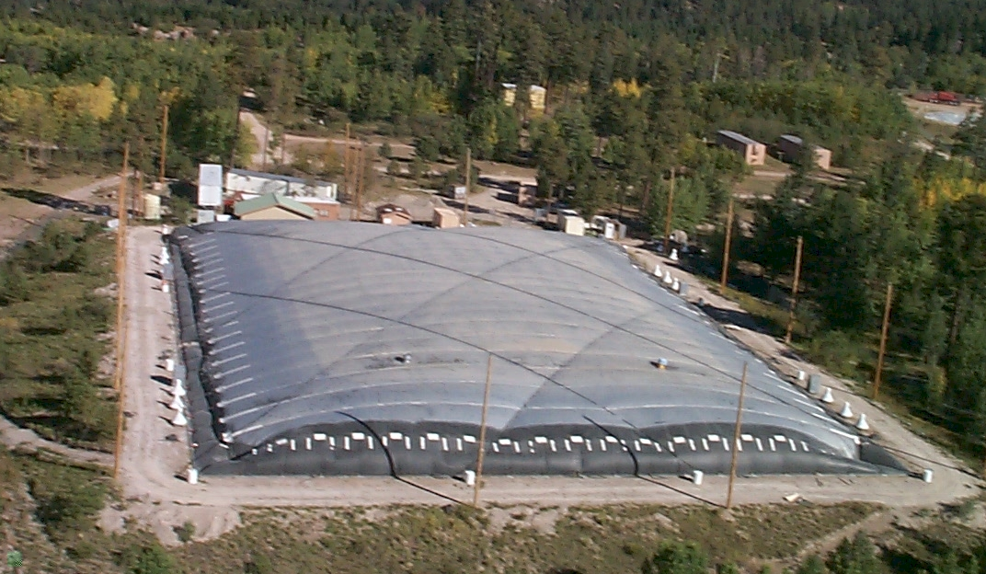

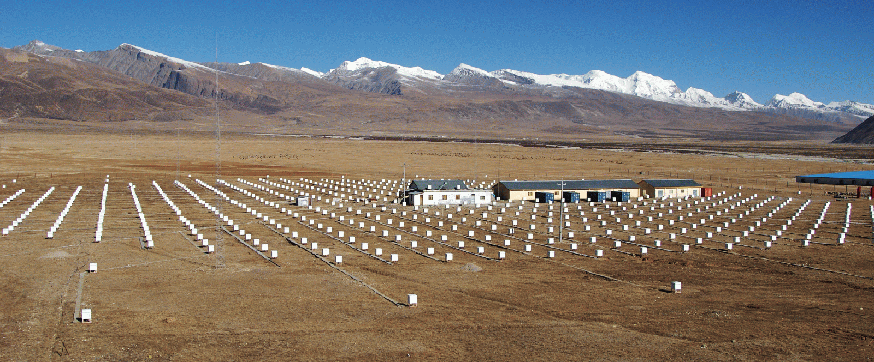
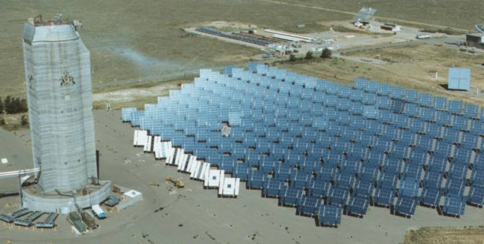
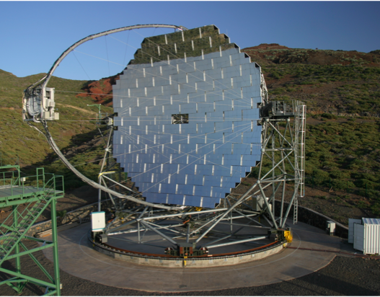
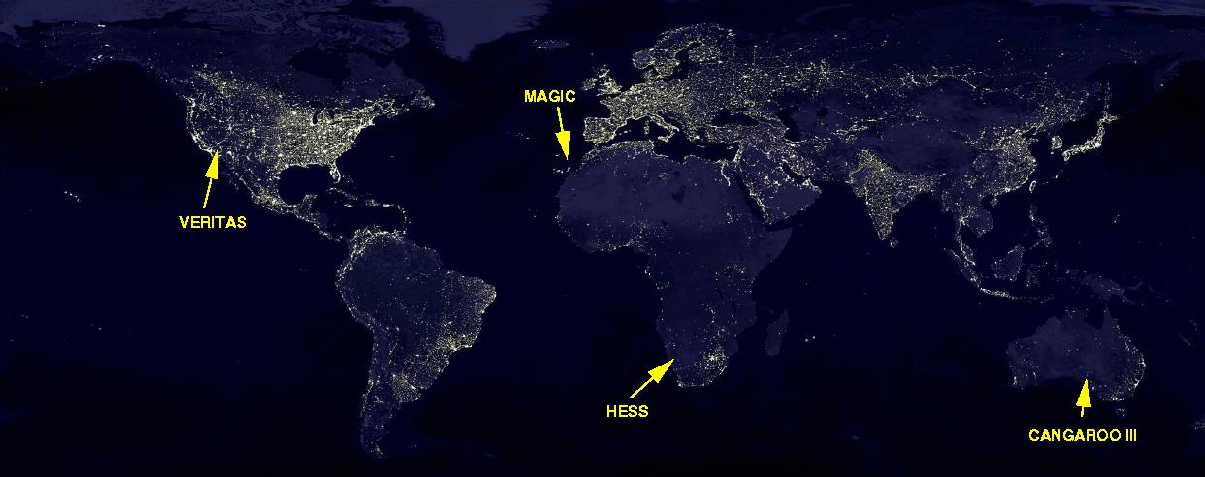
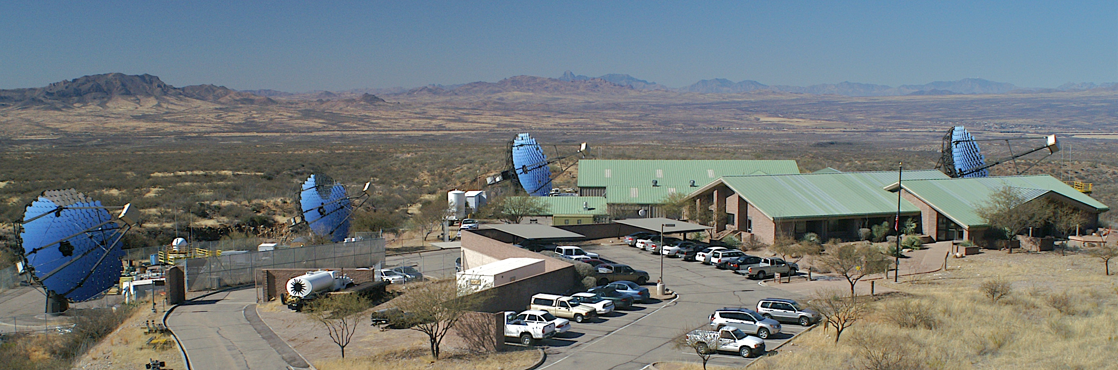
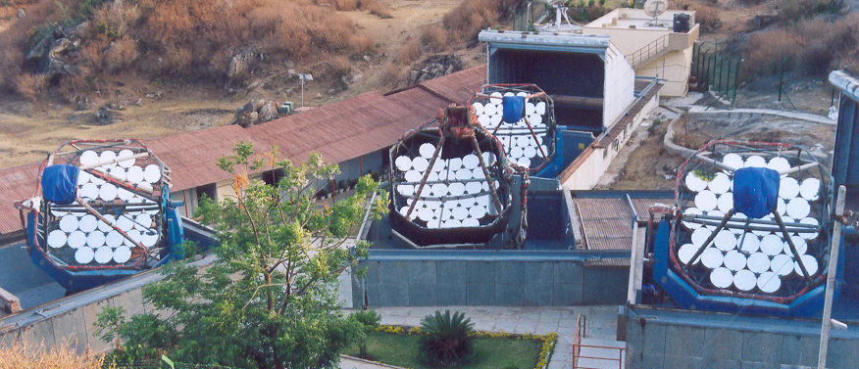
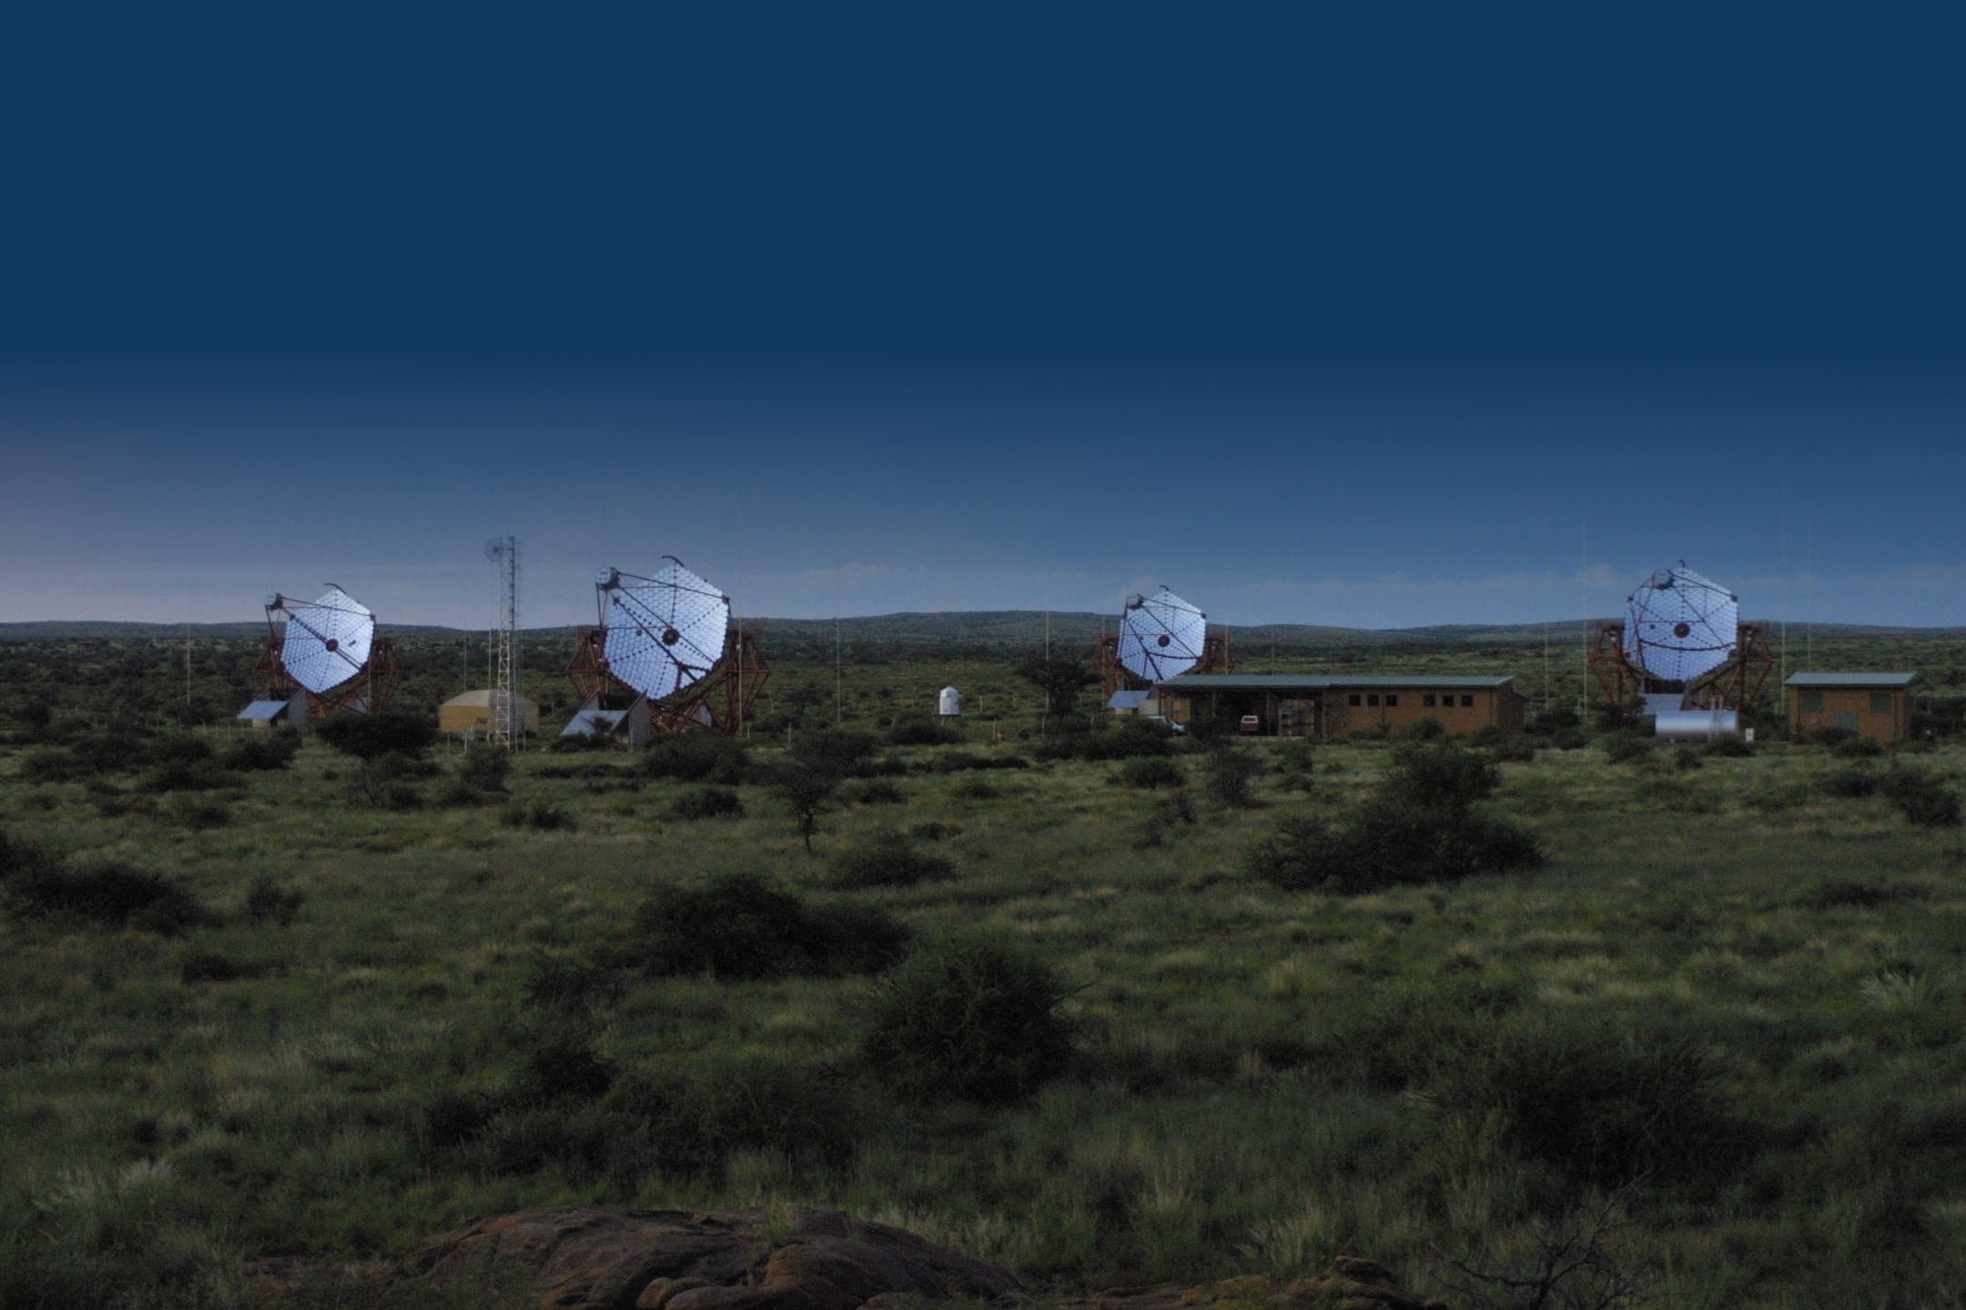
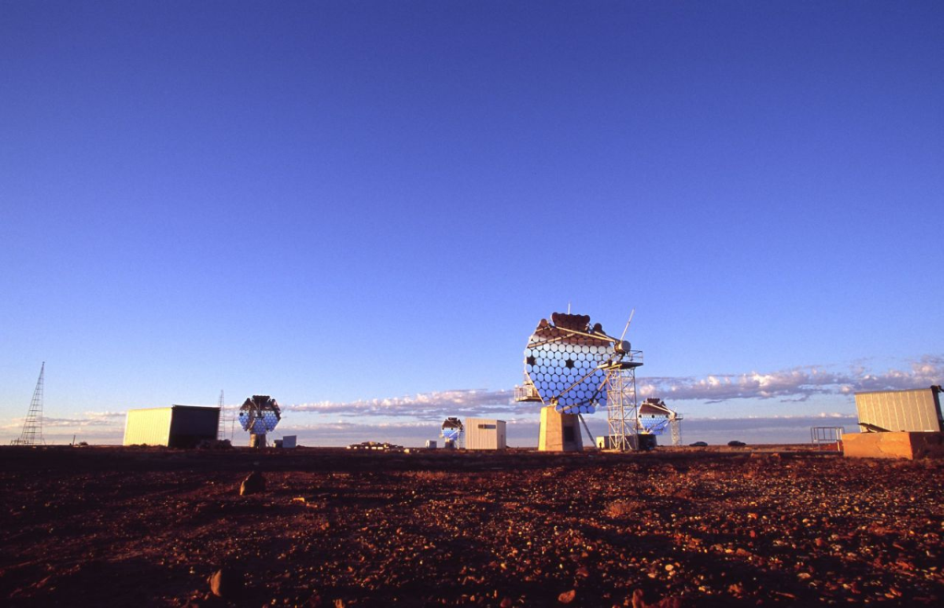
Ground based γ-ray instruments
MILAGRO
TIBET
STACEE
MAGIC
TIBET
ARGO-YBJ
MILAGRO
STACEE
TACTIC
PACT
GRAPES
VERITAS
TACTIC
HESS
CANGAROO

Slide 14
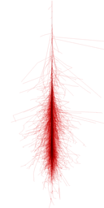
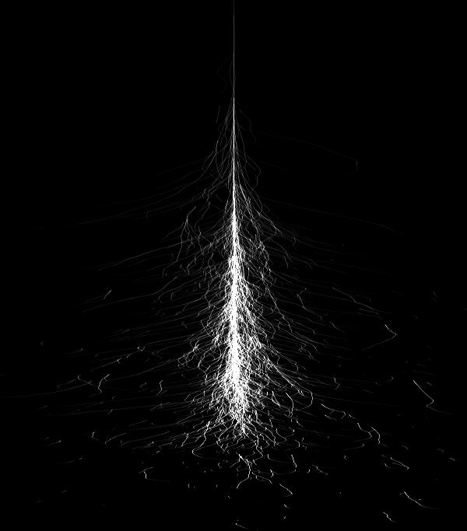
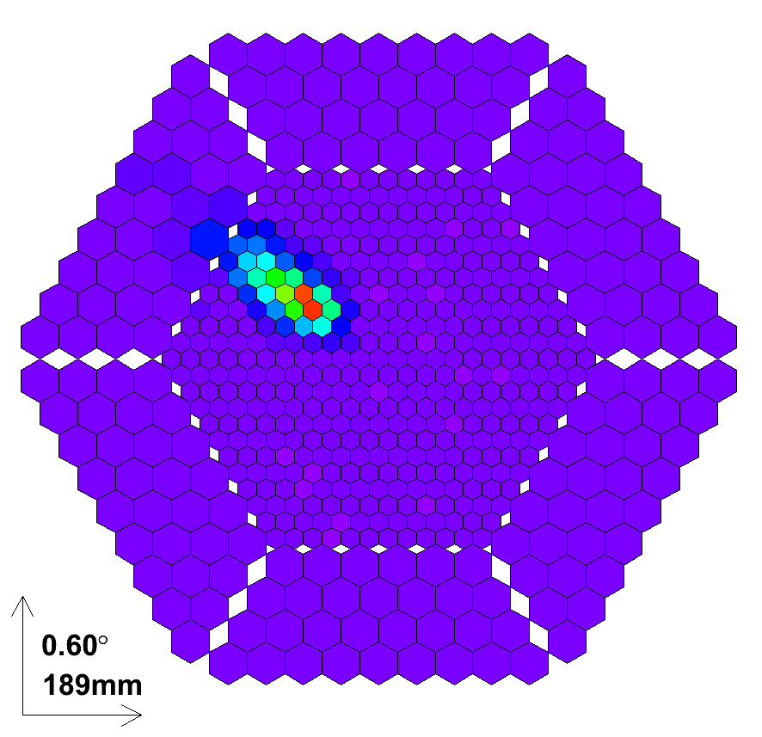
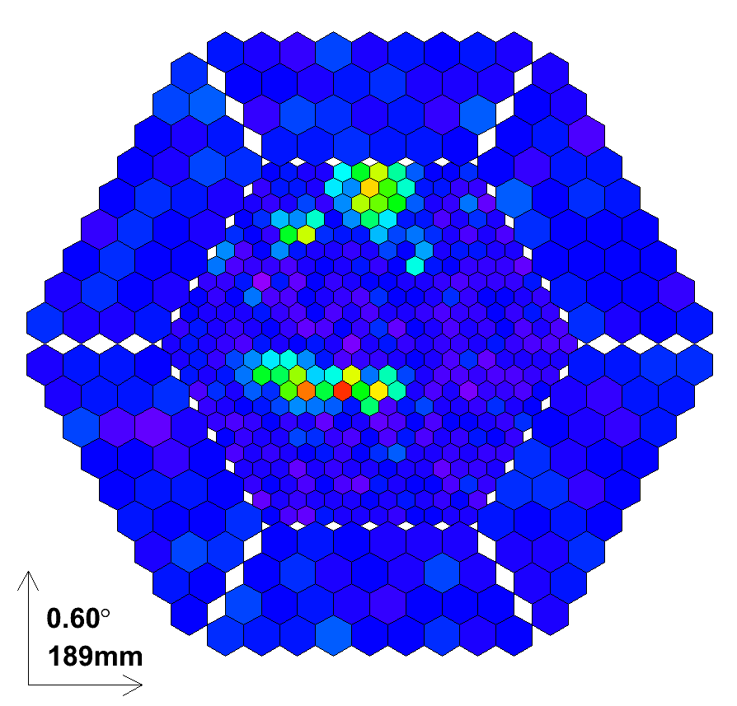
Imaging Atmospheric Cherenkov Telescopes (IACTs)
Detect the Cherenkov radiation from charged particles in EAS mirror reflects and concentrates the light in the camera plane
An image of the shower formed in the camera plane
Cherenkov flash lasts a few nanoseconds. Fast PMTs and readout record the image
Particle
shower
Gamma event
Hadron event
~ 10 km
~ 1º
Cherenkov light
Background (cosmic rays induced EAS) orders of magnitude above signal
~ 120 m

Slide 15
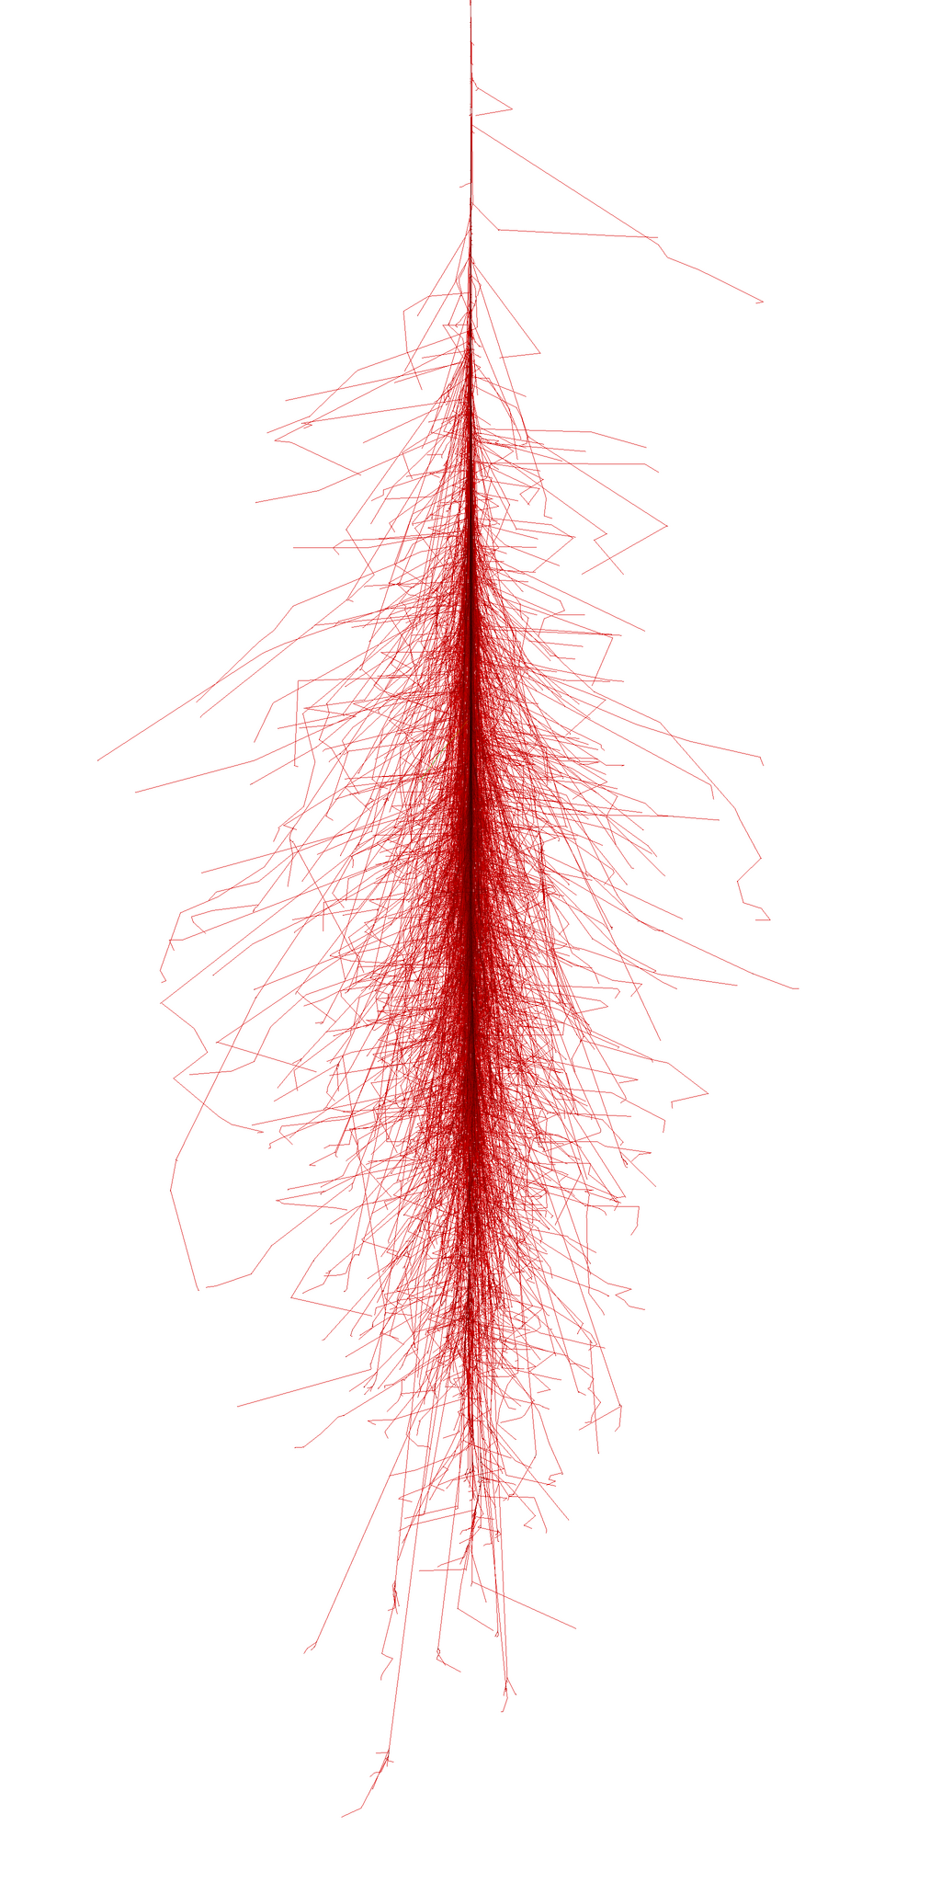
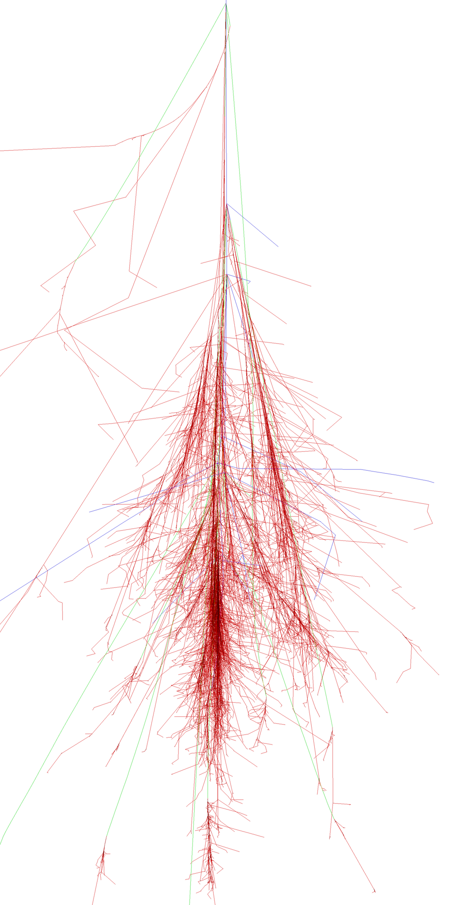
Imaging Atmospheric Cherenkov Telescopes (IACTs)
gamma 50 GeV
proton 100 GeV

Slide 16
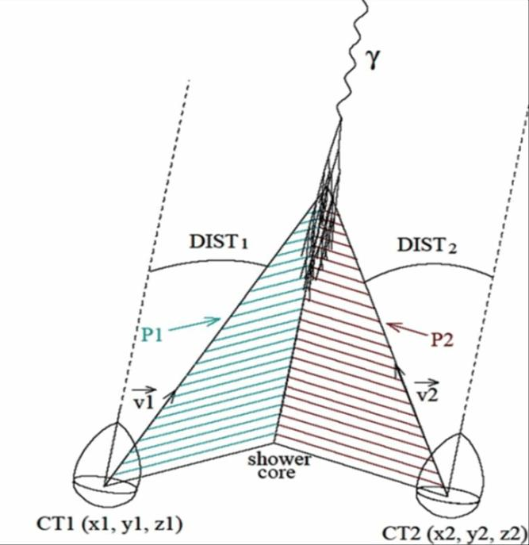
Stereo technique
With 2 telescopes one can obtain 3D parameters of the shower
Height
Impact
Precise direction of γ-ray
Improved background
rejection

Slide 17
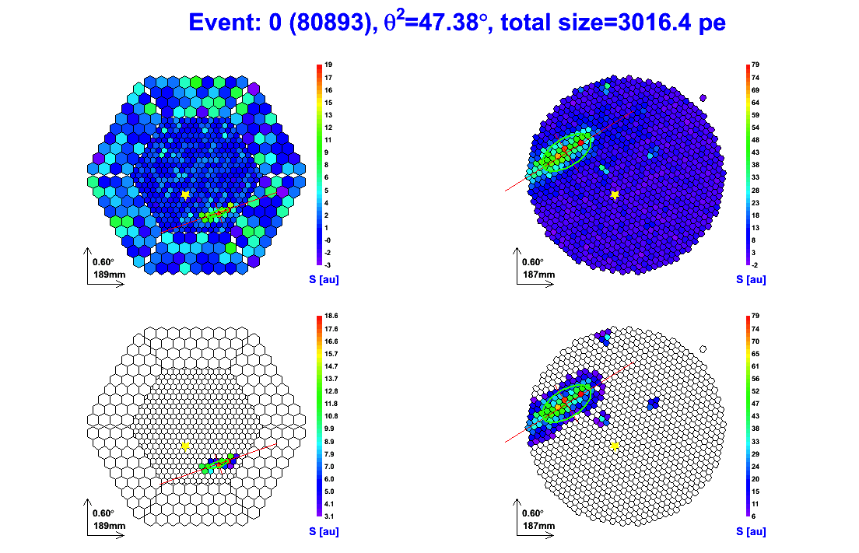
Imaging Atmospheric Cherenkov Telescopes (IACTs)

Slide 18
Imaging Atmospheric Cherenkov Telescopes (IACTs)
Historical evolution:
  First Cherenkov light detected from a EAS in 1953
  Attempts to detect emission from astronomical objects since the sixties
  First generation IACTs: Whipple telescope
    Detection of the 1st VHE source, the Crab Nebula, 1989
  Next evolution: HEGRA telescope array
    Stereoscopic observations. Improved sensitivity
  New generation instruments: Cangaroo, H.E.S.S., VERITAS & MAGIC
  Future: The Cherenkov Telescope Array (CTA)

Slide 19
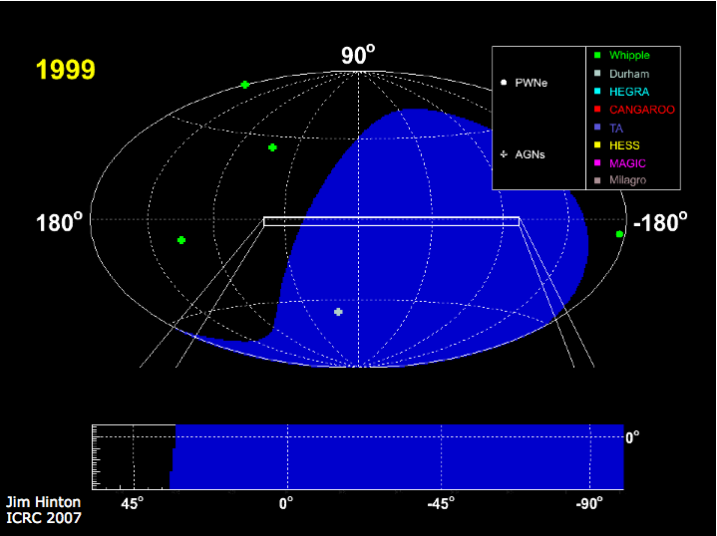
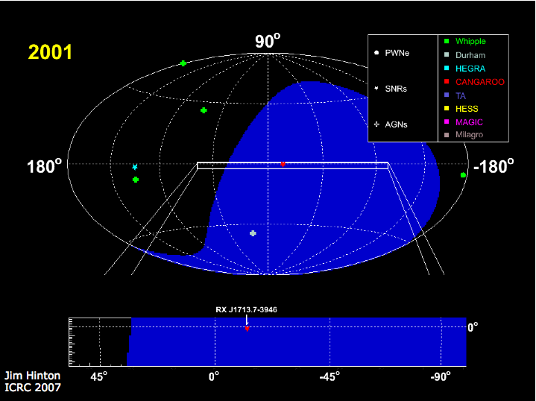
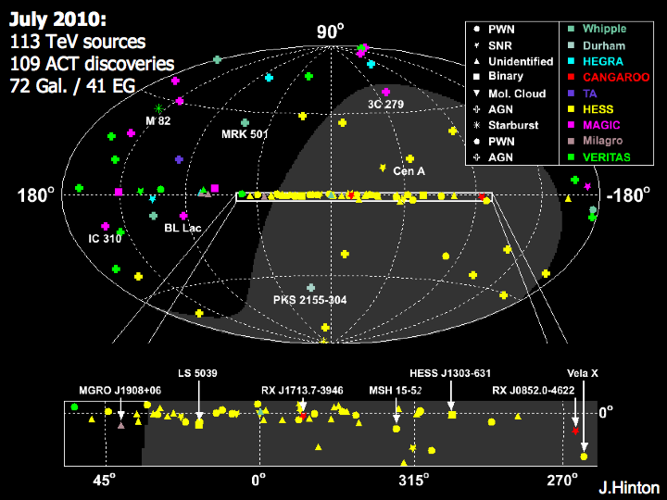
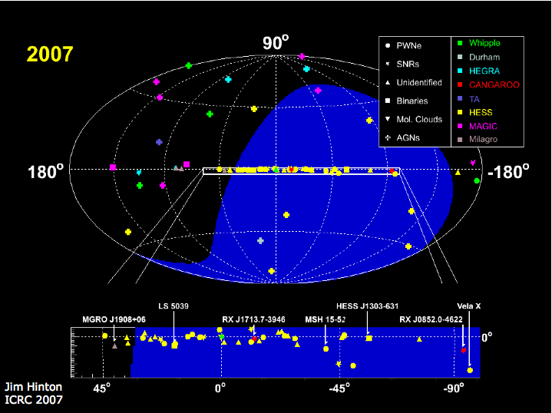
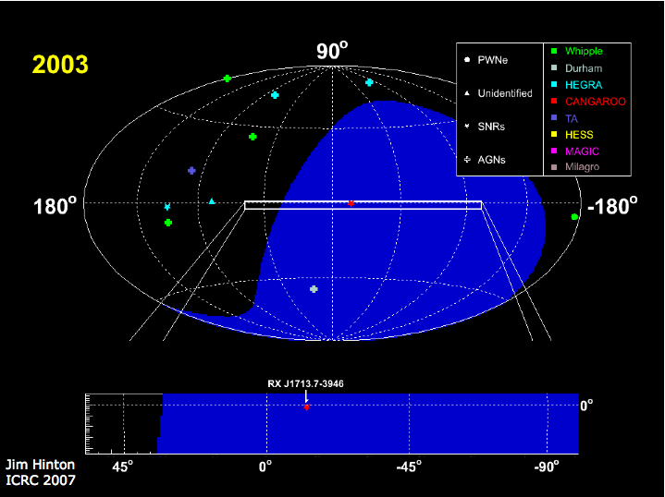
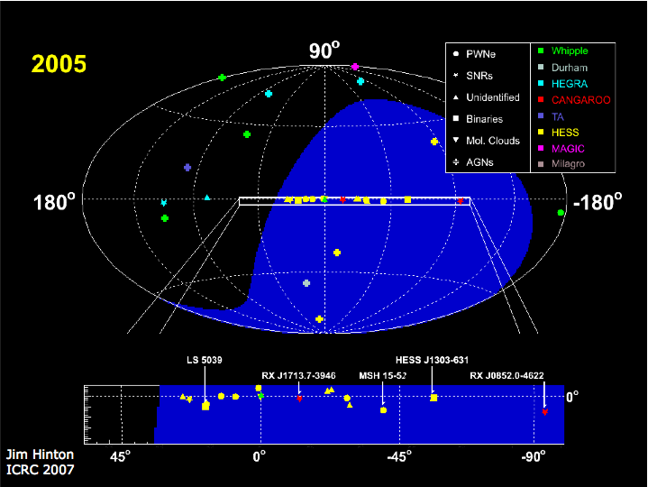
Rapid development of IACTs
November 2010:
116 sources
113 IACT discoveries
72 Gal. / 44 EG

Slide 20
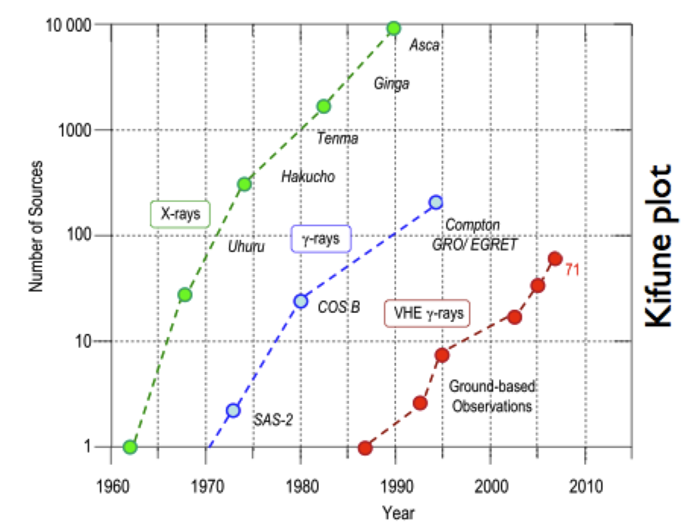
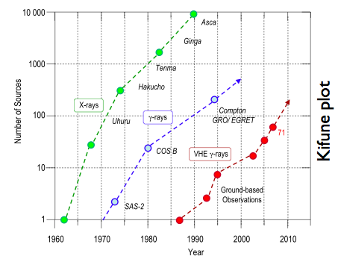
Rapid development of γ-ray astronomy
FERMI
1451
116

Slide 21
Current state of VHE γ-ray astronomy
- The MAGIC telescopes
- MAGIC Results

Slide 22
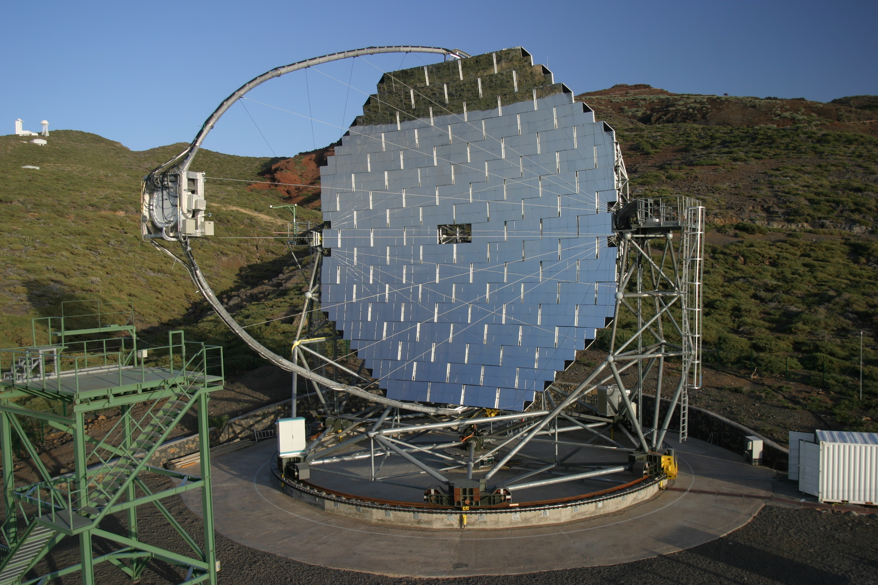
The MAGIC-1 Telescope
Largest mirror in the world, 17m ∅ Parabolic dish (234 m²)
3.5° ∅ FOV photomultiplier camera with 576 enhanced QE PMTs
Trigger threshold: 55 GeV (25 GeV!)
Sensitivity: 1.6% Crab Nebula in
50 hours at E=270 GeV
(enhanced by timing information from
new 2GS/s FADC)
PSF ~0.1°
Energy resolution ~20%
Enhanced duty cycle (moon & twilight
observations +50%)

Slide 23
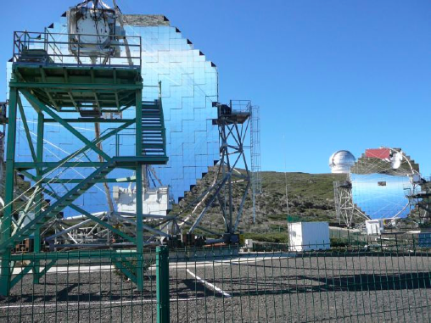
The MAGIC Telescopes
MAGIC-2 in operation since Fall 2009
Same FoV, Diameter and telescope structure as MAGIC-1
Performances of the stereo system:
    Energy threshold 50 GeV (analysis)
    Sensitivity: <1.0% Crab in 50 h
    Angular resolution: 0.07° (σ 2D)
    Energy resolution: ~17%
    Fast repositioning (<20 sec!)
Lowest Energy threshold among IACTs !

Slide 24

Low Energy VHE γ-ray Astronomy
Interesting to look at low energies
    Measure soft spectra, cut-offs
  Objects with higher redshift,
  not visible at higher energies
  Overlap with other instruments (FERMI)
  Less explored region
  More sources
Source | Redshift | Type | Experiment
1ES 1011+496 | 0.21 | FR-I | MAGIC
1ES 0414+009 | 0.29 | HBL | HESS
S5 0716+71 | 0.31 | HBL | MAGIC
1ES 0502+675 | 0.34 | HBL | VERITAS
PKS 1510-089 | 0.36 | FSRQ | HESS
PKS 1222+21 | 0.43 | FSRQ | MAGIC
3C 66A | 0.44 (?) | IBL | VERITAS
3C 279 | 0.54 | FSRQ | MAGIC

Slide 25
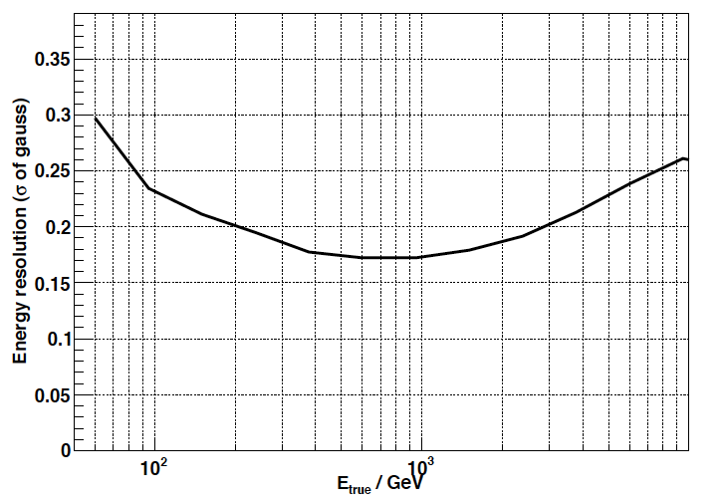


Performances
Energy resolution
Sensitivity. Flux required to detect a source (N_{excess}/√N_{background}=5) in 50 h:
MAGIC-1
MAGIC Stereo
Angular resolution

Slide 26



Other IACTs in operation
H.E.S.S.-II a 28 m IACT + 4 x 12 m telescopes
VERITAS, 4 x 12 m telescopes

Slide 27










Galactic MAGIC sources
MAGIC has discovered 4 galactic sources and detected 6 more
Crab Nebula
Crab Pulsar
Galactic Center
HESS J1813
HESS J1834
LSI 61+303
IC 443
Cygnus X-1
TeV 2032
Cas A

Slide 28
The Crab Nebula
Nebula after SN1054
Considered as the standard candle of VHE γ-rays
Peak of synchrotron emission clearly seen thanks to FERMI+MAGIC
HE emission variability observed by FERMI and AGILE
No sign of variability seen by MAGIC or VERITAS, but hint of variability at higher energies (ARGO)

Slide 29

Crab Pulsar
3.4 sigma
Winter 2007/2008 22.3 hours of data
  low zenith angle, good weather, light and hardware conditions
Dedicated Low threshold trigger (Sum trigger)
6.4 sigma above 25 GeV (3.4 sigma E>60 GeV)
Decreasing of P1/P2
Exponential cutoff:
E0=17.7 ± 2.8stat ± 5.0syst
Aliu et al., Science 322 (2008) 1221

Slide 30

Crab Pulsar
If superexponential cutoff assumed, lower limit on the distance of the emitting region: 6.2 ± 0.2stat ± 0.4syst NS radii
Aliu et al., Science 322 (2008) 1221

Slide 31




Crab Pulsar
If superexponential cutoff assumed, lower limit on the distance of the emitting region: 6.2 ± 0.2stat ± 0.4syst NS radii
FERMI measured cutoff 5.8 ± 0.5 ± 1.5 GeV. Compatible with MAGIC if EGRET data added to the fit
FERMI Minimum emission height
> 3.4 NS radii
Abdo, A. A. et al. 2010, ApJ, 708, 1254
MAGIC Follow-up observations:
2007-2008 + 2008-2009 data
7.5 sigma above 25 GeV

Slide 32


IC 443/MAGIC J0616+225
Soft spectrum (α = -3.1) between 100 GeV and 1 TeV, with no break
Extension below MAGIC angular resolution ( ~ 0.1°)
MAGIC source displaced with respect to center of EGRET source
MAGIC source correlated with a molecular cloud and maser emission
This suggests the hadronic origin of the VHE emission
Albert et al. 2007, ApJ 664, L87

Slide 33


LSI 61+303
High mass X-ray binary system
Discovered by MAGIC in VHE Υ-rays 2005-2006. Highest emission phase 0.6-0.7
Quiet at periastron. 2nd peak Dec 2008 phase 0.8-0.9
LS I +31 606 VHE emission is periodic.
P = (26.8 ± 0.2) days
Compatible with the orbital periodicity found in other wavelengths
Multiwavelength campaign October-November 2006
No gamma-radio correlation. Possible
X-ray - gamma correlation
J. Albert et al., Science 312, 1771 (2006)
J. Albert et al., Astrophys. J. 693 (2009) 303

Slide 34





Bright Blazars monitoring
Regular observations of bright TeV Blazars: Mkn 501, Mkn 421, 1ES 1959+650, 1ES 2344+514
Mrk 421, 2008
r=0.74±0.05
8.4σ from zero
Optical
Mkn 421
preliminary
preliminary
ASM
X/VHE
Swift
Jan 20th - April 30th: FERMI-MAGIC simultaneous data
O/VHE
MW campaing
Radio: OVRO, Effelsberg, Noto...
Infrared: WIRO...
OpTc al: GASP, GRT, MITSuMe...
X‐ray: Swiu, RXTE
Gamma‐ray: Fermi
VHE: MAGIC, VERITAS
preliminary
BAT
  moon
  time
Participation in multiwavelength campaigns
  Mrk421 campaign triggered by Hard X-ray flare June 2008
  Mrk 421 campaign Jan-May 2009
Donnarumma et al., ApJ Lett. in press
(AGILE, Swift, MAGIC, VERITAS, GASP-WEBT)

Slide 35






Extragalactic sources with Optical triggers
Mkn 180
z = 0.045
Trigger point
March 2006
MAGIC 12.1 h
S=5.5 σ
Albert et al. 2006 ApJ, 648, L105
1ES 1011+496
z = 0.212
Trigger point
March-May 07
KVA optical telescope at la Palma
MAGIC 18.7h
S=6.2 σ
Albert et al. 2007 ApJ, 667, L21
S5 0716+714
z = 0.31
April 08
Significance 6.8 σ
H. Anderhub et al., Astrophys. J. 704 (2009) L129

Slide 36



M87
Radio
VLBA 8 GHz
Radio galaxy with super massive black hole ~6×10⁹ M⊙ at ~16 Mpc. Jet structure with knots, sometimes brighter than nucleus
Science, 325 (2009) 444
Harris+07
HST-1
VHE
knot A
knot D
X-rays
Chandra
VHE flare
core
Followed by increase of radio flare close BH
Multiwavelength campaign Jan-Feb 2008 (VERITAS, HESS, MAGIC and Radio, X-ray)
Triggered by MAGIC detection on 1st February flare (9.9σ; 8.0σ single night)
Fast variability. TeV correlated with radio and X-ray emission from core
New MAGIC ATel in 2010 (#2431)
X-ray
knot HST-1
nucleus
nucleus
Radio
jet

Slide 37
IC 310
Head-tail radio galaxy. Detection (ATEL #2510) triggered by FERMI data
Flux above 300 GeV ~2.5% of Crab
Favored scenario with VHE γ-rays coming from the inner jet close to the central engine
Flat spectrum spreads over more than 3 orders of magnitude

Slide 38
Most recent new sources from MAGIC
Outburst from FSRQ 4C +2135, z=0.432
Stereo observation under low Moon
> 8σ in 0.5 hours on June 17th 2010
Flux level ~30% Crab above 100 GeV
ATEL #2684, 19th June
Recently identified as a BL Lac object, z unknown
Stereo observation on 17th July resulted in a discovery with ~7σ in ~1.5 hours
Flux level ~20% Crab above 100 GeV
Indications of variability in MAGIC and Swift data
ATEL #2753, 22nd July
Perseus Cluster at 77.7 Mpc (z=0.018). Brightest X-ray cluster
Central radio galaxy NGC 1275 emitter of γ-rays E>100 MeV
MAGIC detected emission from NGC-1275
ATEL #2916, 10th October

Slide 39



Extragalactic background light (EBL)
Measured spectra affected by attenuation in the EBL

Slide 40



3C279
Flat Spectrum Radio Quasar at z=0.536
Brightest EGRET AGN (Wehrle+97,98)
Gamma-ray flares in 1991 and 1996:
High dynamical range in EGRET data
Rapid variability: ΔT ~ 6hr in 1996 flare
MAGIC observations:
2006 January–April during
    Energy spectrum of 3C 279
    excluded
    α=4.1
MAGIC Coll., Science 320 (2008) 1752
MAGIC: E>100 GeV
6.2σ
2.2σ
    excluded
    still allowed
Flux incompatible with const.: 5.04 σ

Slide 41





QG & Lorentz invariance violation
Astrophysical observations can test possible LIV due to Quantum Gravity structure of space-time
(Ellis, Mavromatos,Nanopoulos, Sakharov 2003)
Foamy structure of quantum space-time:
  Space-time at large distances is “smooth” but
  at very short distances might show a very
  complex structure
The effect can be treated by a perturbative expansion (E << Mplanck)
Need very fast transient phenomena (timestamp) for the simultaneous emission of gamma-rays at different energies

Slide 42

Energy-delayed flare Mrk501
2 flares observed in 30th June & 9th July 2005 (~4 Crab)
30th June flare seen only 250-600 GeV range.
9th July flare seen in all energy ranges
Time delay between highest and lowest energy bins
Astrophysical origin:
  Gradually inefficient acceleration
  Gradually accelerating blob (Bednarek & Wagner 2008)
Or propagation effect?
150-250 GeV
250-600 GeV
600-1200 GeV
Albert et al. 2008 ApJ, 675, L25
>1200 GeV

Slide 43


Quantifying the delay
Quantification of the delay using 2 methods
  Energy cost function: minimize spread of a dispersive broadened pulse
  Maximum likelihood
Both yield a delay of 0.030±0.012 s/GeV
Probability of no delay 2.6%
Propagation effect due to Lorentz invariance violation
  M_{QG} ~ 0.4×10¹⁸ GeV
But effect Marginal:
  M_{QG} > 0.26×10¹⁸ GeV
MAGIC Collaboration and J. Ellis et al. 2008 Phys. Lett. B668, 253

Slide 44

γ-rays from Dark Matter
Neutralinos are an ideal Dark Matter candidate
Neutralinos annihilate and produce SM particles
Look for regions with high (ρ_{DM})²: Galactic center, Clusters, Spheroidal dwarfs, minihalos, IMBHs
q-jets produce more gs, but t produce higher energy gs
VHE gs are rare or at rather low E

Slide 45

MAGIC observations: Draco
Dwarf spheroidal galaxy. High Mass/Light ration. 82 Kpc from galactic center. Good candidate for searches
7.8 h good quality data. Large zenith angle (37°), Ethreshold=140GeV
Upper limit ≈ 10⁻¹¹ gcm⁻²s⁻¹ (assuming α=1.5)
But UL depends on expected spectra (spectral index and cut-off). Different for each mSUGRA model
No constraints on mSugra phase space.
Very high gamma flux enhancements ruled out (>1000)
Albert et al. 2008 ApJ 689, 428

Slide 46
Internal Bremstrahlung
Internal bremstrahlung contribution not properly taken into account in previous calculations
Bringmann, Bergstrom, Edsjo; JHEP 0801,049 (2008)
γ-rays have an energy
> 0.5 m_{χ}
Perfect for the IACTs
We can look for annihilation lines in the spectra of the sources

Slide 47
UFOs (Unidentified Fermi Object)
FERMI could find objects without counterparts in other wavelengths, but all with the same spectrum
And the spectrum could be
compatible with a DM model
Very likely that FERMI does
not have enough energy range
to measure full spectrum and
cutoff
IACTs could measure the VHE
γ-rays

Slide 48
Future of VHE γ-ray astronomy: CTA

Slide 49
Why do we need CTA?
We need to improve to continue the expansion of the VHE gamma-ray astronomy

Slide 50
What do we need?
Factor 10 improvement in sensitivity in the “Core” energy range (200 GeV – 1TeV)
  Order of ~1000 sources are expected
  Precision studies of individual objects
  Improved energy and angular resolution
Example: Simulated galactic scan with uniform exposure
G. Hermann, 2008

Slide 51
What angular resolution we need
Sub-structures in SNR shocks will become visible
Source morphology

Slide 52
What energy range we need
Dynamic range ~10s GeV into 100 TeV range (together with Fermi a factor ~10⁷ energy coverage)
  Crucial for understanding physical processes in sources
  Electron vs hadron scenarios
  Cutoffs in energy spectra at low and high energies
HESS, Fermi, RXTE,ATOM (2009)
Morlino, Balsi, Amato (2009)

Slide 53
The CTA observatory
One observatory operating 2 sites by one consortium
  Full sky coverage in VHE gamma-rays
Southern Array (2/3 of total cost):
  Full energy and sensitivity coverage (~10s of GeV to ~100 TeV)
  Angular resolution from 0.02° to 0.2°
  Large FoV for Galactic and Extragalactic sources
Northern Array (1/3 of total cost):
  Low energy range (~10s GeV to TeVs)
  Small FoV, devoted mainly to extragalactic sources

Slide 54

Where to build CTA

Slide 55

How to build CTA?

Slide 56

How to build CTA?
Needed:
  50-100 telescopes core array
  ~10000 m² mirror area
  ~70 m² photo sensitive area
  ~10⁵ electronics channels
Factor of 10 in sensitivity with only factor of 10 in cost
Find an optimized array layout that has the required performance
Optimize design for effective production / commissioning, and for stability and high reliability
Studied in the design study phase (2008-2010)
On astro-ph:
arXiv:1008.3703

Slide 57




Telescope structure
Designs for the different telescope types

Slide 58
Photosensors
Baseline design using PMTs
Cooperation with manufacturers to improve/adapt performance to CTA specific requirements: e.g. low afterpulsing, hi QE
Price as low as possible (1.0-2.0 x 10⁵ PMTs)
Investigate developments on SiPMTs

Slide 59
Trigger+Readout
Camera Trigger
  2 possibilities are discussed Digital trigger and Analog trigger (CIEMAT working on the analog trigger decision distribution)
Camera Readout. Many options available
  DRAGON: Based in the DRS4 chip
  NECTAR: another ring sampler chip
  FLASHCAM: part of the fully digital camera
  TARGET: USA development for AGIS
  DRS4 Japan
Evaluation boards built or in preparation

Slide 60

Array layout
Full MC simulations of possible array layouts with the same construction cost
Simulated a super-array of 275 telescopes
Candidate arrays selected as a subsample of the super-array
Study array performance and Physics performance
Reduce the parameter space, optimize the array layout

Slide 61
Array Layout
We have studied different array layouts with different types and numbers of telescopes with the same construction cost
3 examples:

Slide 62


Array Layout
The objectives can be reached! We can find cost-effective arrays with the required sensitivity and energy coverage:
And also for the angular resolution!

Slide 63

CTA observation modes
Very deep field

Slide 64
CTA observation modes
Monitoring
4 Telescopes
Monitoring
4 telescope
Deep field
~1/2 of telescopes
Monitoring
4 telescopes
Deep field
~1/3 of telescopes
Monitoring
1 telescope

Slide 65
CTA Observation modes
Survey
mode

Slide 66
CTA, an open observatory
Large number of detectable objects main motivation to operate CTA as an open observatory
  Provide tools for data dissemination and data analysis
Large number of users from astronomy, astroparticle and particle physics, cosmology, …

Slide 67

CTA Consortium
25 countries
132 institutes
734 people
220 FTEs

Slide 68
CTA Timeline

Slide 69
Conclusions

Slide 70
Conclusions
Last few (~5) years have been very exciting in VHE γ-ray astronomy
  Many new discoveries
  IACTs confirmed as the best option to study the VHE Universe
CTA is the instrument that will exploit the potential of this technique the next 10-15 years
Transition from Experiments to Observatory. CTA a facility open for the astronomical community

